Slide 1
















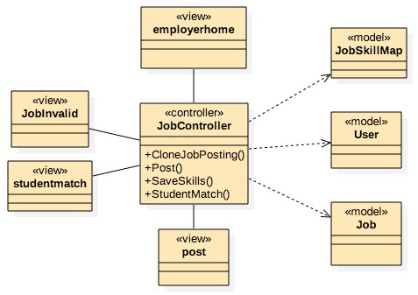
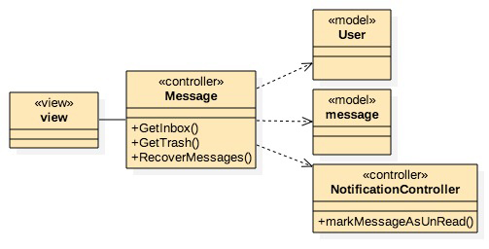


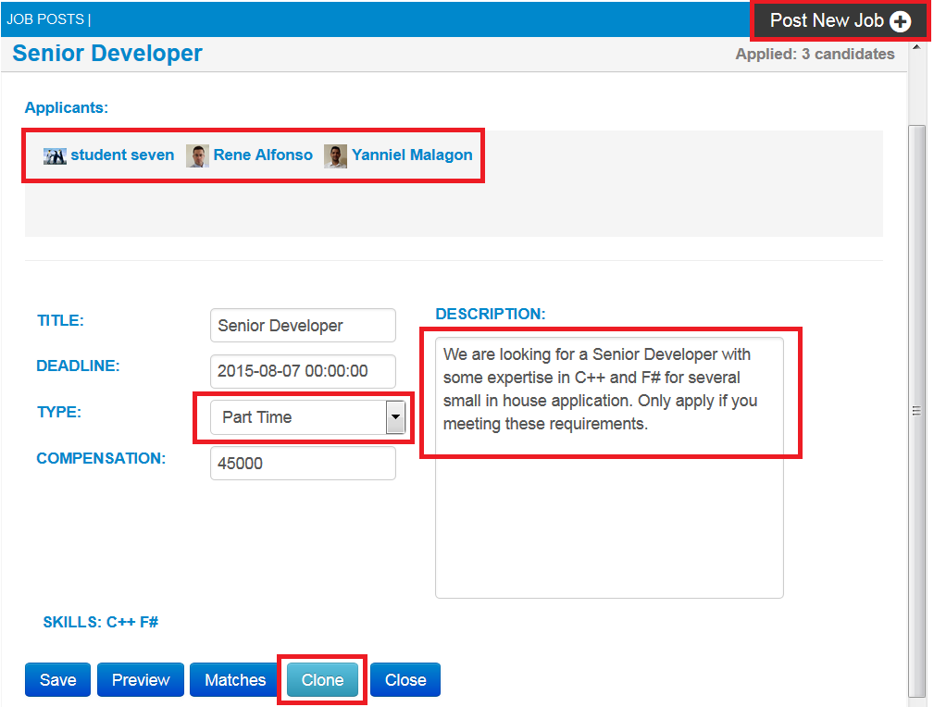
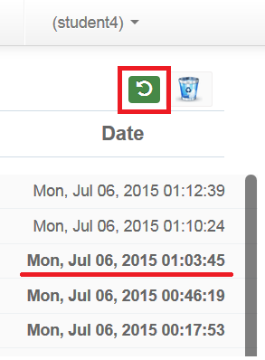
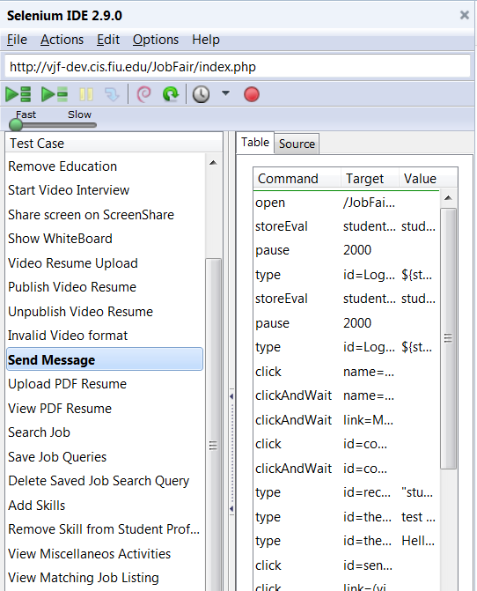
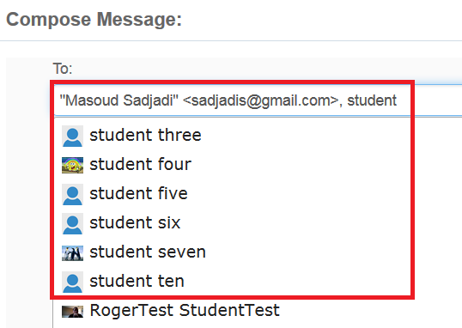

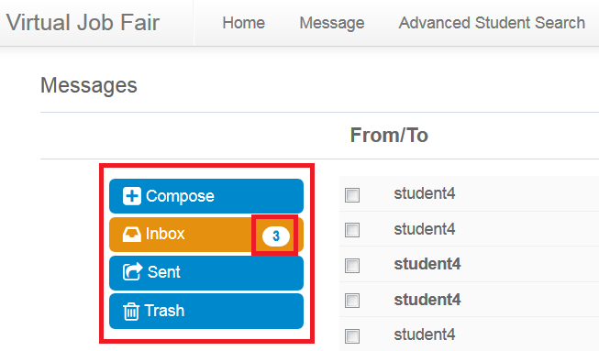
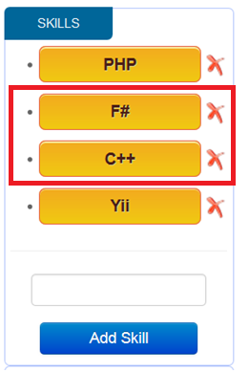
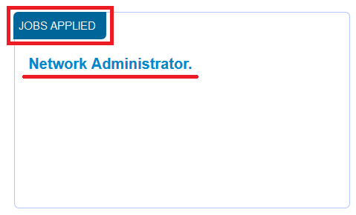
School of Computing & Information Sciences
Senior Project, 2015, Summer
V6.0
Virtual Job Fair v6.0
Student: Yanniel J. Malagon, Florida International University
Mentor: Masoud Sadjadi, FIU
Instructor: Masoud Sadjadi, Florida International University
Problem
Current System
Requirements
There are two main issues that make the hiring process difficult for students and employers. First, it is very expensive for employers to participate in Job Fairs or recruit student from different universities. Also, they do not have a wide range of selection nor the financial resources to find the perfect candidate for the job. Secondly, many students do not have the means or time to meet with potential employers in person. In addition, most students cannot show their skills, experience and talent to employers through emails.
Consequently, they might lose great job opportunities. Virtual Job Fair (VJF) is designed to solve these issues. Therefore, VJF is a win-win opportunity for both the student and employer.
The current system is in need of many improvements to help facilitate users experience in the site. The current system does not provide the following features and improvements:
Recover Deleted Messages
List Applied Jobs
Display active mailbox container
Cloning Job Posts
Display number of unread messages
Add skills with special characters
Recipients Address String Validation
Job Application Button
LinkedIn login and profile information retrieval
Reply messages correctly
Add multiple recipients using the autocomplete
Display correct date and time in messages
Remove expired jobs from available job listing
Display job description in clear text format
Test all student actor features
Allow students to list all jobs applied, clone existing jobs, and add skills with special characters.
Allow users to recover deleted messages
Improve message subsystem Graphic User Interface.
Allow student to login and retrieve their LinkedIn profile information.
Remove expired job posts from available job listing
Validate recipients list in the “To” field before submitting messages.
Display active mailbox container, number of unread messages and valid date and time.
Display job description in clear text format
Add job application button and confirmation message.
Reply messages correctly and add multiple recipients using the auto complete feature
System Design
Object Design
Implementation
The system design is based on a Model View Controller architectural pattern (MVC), provided by the YII framework.
Below are two of the new user stories implemented on Virtual Job Fair v6.0
Job Cloning Class Diagram
Message Recover Class Diagram
Virtual Job Fair v6.0 uses a Model View Controller architectural pattern provided by the Yii framework. The system was implemented using multiple programming languages and technologies.
  Front End:
  HTML, CSS3, Bootstrap & JavaScript
  Backend:
  Yii framework controls the application logic through the interaction with models, views and controllers.
  Dynamic Content:
  PHP, JQuery, JavaScript, JSON & Yii
  Validations: JQuery & JavaScript
  Searches:
  Solr Search Engine / MySQL integration
  Data Storage: MySQL database
  Regression Testing:
  Selenium IDE, HTML5, CSS3 & JavaScript
1-HTTP Request
Yii Router
7-HTML
2-Action
View
5-Invoke
Controller
3-Call
Model
6-HTML
4-Send Content
Verification
Screenshots
Summary
Initially we used Selenium IDE 2.9 to test all features available in the system. We separated the tests in three main groups: Student, Admin and Employer test suites. Developing these script automated test cases allowed us to identify several bugs that needed to be corrected in the system. Integration tests was performed after every code completion of a bug fix or new system implementation to guarantee a correct behavior of the application.
Virtual Job Fair 6.0 was an incredible experience for me. During this project I was able to deeply explore a new programing language like JavaScript and a new PHP framework like Yii. After five Sprints of intense Scrum Development, we were able to fix 53 system bugs, create 77 regression system test cases, and implement 10 new features that satisfy the needs of the users. I am very proud of contributing in the enhancement of several VJF application subsystems such as Message, Job, Skills and User.
I am very glad that we had the opportunity to improve and contribute to the development of a promising application like Virtual Job Fair.
Acknowledgement
The material presented in this poster is based upon the work supported by Masoud Sadjadi.
I am thankful to the help that I received from my group member Rene Alfonso and the support of my family.

